Slide 1
Deep Painterly Harmonization​
M10909301 蔡忠諺​
M10909315 黃柏崴​
Notes:
The topic we're going to talk about is Deep Painterly Harmonization. This is a kind of style transfer

Slide 2
Agenda
Introduction​
01
Related work
02
03
Deep Painterly Harmonization Process​
Result
04
Conclusion
05
Notes:
This is our agenda

Slide 3
01
PART
Introduction​

Slide 4



1.1 Motivation​
To create some interesting pictures​
To implement the Neural network​
This technology has marketing, media and social media value
Compare the difference between the paper and the implementation​
Notes:
Why do we want to make this project?
Because we often see a lot of interesting meme, suddenly thought of making related themes
And recently, we have studied in deep learning related courses, so I would like to implement the Neural network​ through the project
We think this technology can be used as a way for corporate marketing, media and social media
Finally, we hope to compare the difference between the paper and our implementation​

Slide 5
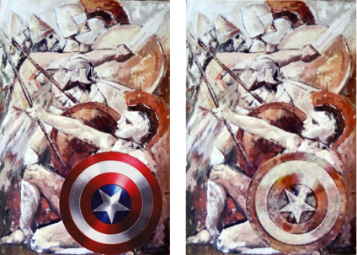
1.2 Reference
Deep Painterly Harmonization
Fujun Luan, Sylvain Paris, Eli Shechtman, Kavita Bala​
First published:：20 July 2018
https://sgugger.github.io/deep-painterly-harmonization.html​
​
Notes:
Many composite photo also look like a collage. So , The paper address these issues with a dedicated algorithm that carefully ​determines the local statistics to be transferred.
The paper ensure both spatial and inter-scale statistical consistency and demonstrate that both aspects are key to generating quality results.
To cope with the diversity of abstraction levels and types of paintings, The paper introduce a technique to adjust the parameters of the transfer depending on the painting.

Slide 6

1.3 Architecture​
Image processing ​
Deep Painterly Harmonization​
Output​
​
The First Pass​
The Second Pass​
Remove background​
Composite picture​
Mask​
Dilation​
Result​

Slide 7
02
PART
​
Related Work​

Slide 8
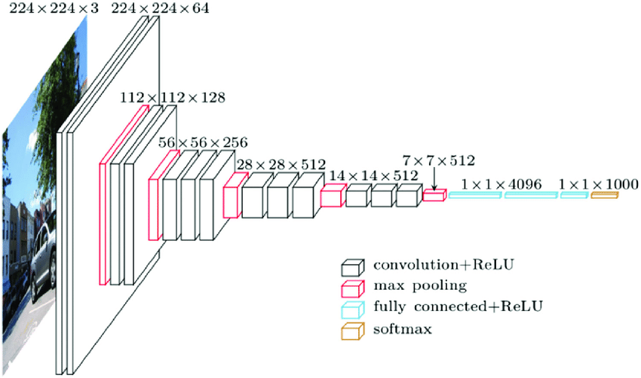
2.1 Algorithm
Small convolution kernel​
Small pooling kernel​
The number of layers is deeper and the feature map is wider​
Use Multi-Scale for data enhancement during training and prediction​
​
Notes:
Now we are to talk what the algorithm we use:
We use the VGG model for training
It’s convolution kernel 3x3 (step size=1, padding=0)
​
And it’s all pooling kernel is 2x2 ​
​
Since the convolution kernel focuses on expanding the number of channels, and the pooling kernel focuses on reducing the width and height, the model architecture is deeper and wider, while the increase in calculation slows down, so that the network has a greater experience.
During training, the same picture is scaled to different sizes and randomly cropped to a size of 224*224, which can increase the amount of data. When predicting, the same picture is scaled to different sizes for prediction, and finally the average is taken.​
​
X
In the network test stage, the 3 full connections in the training stage are replaced with 3 convolutions, and the training parameters are reused in the test, so that the tested full convolutional network can receive any width or height because there is no restriction on full connections input of.​

Slide 9
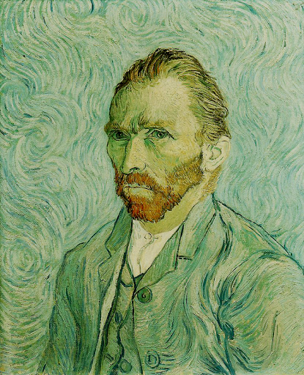
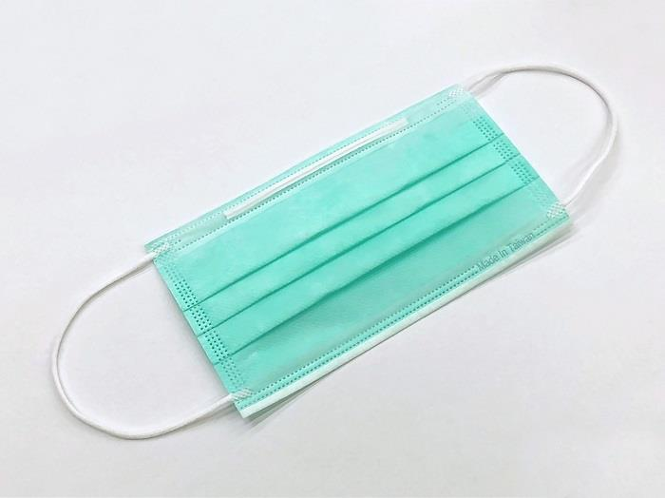
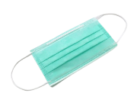
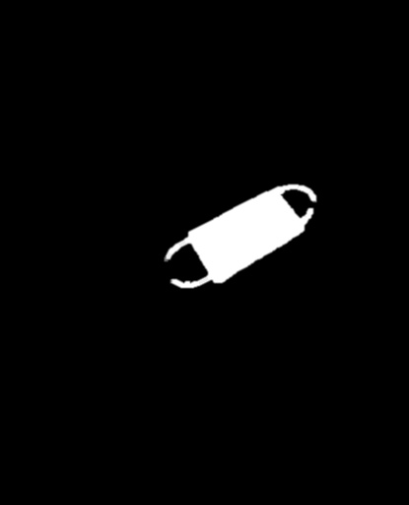

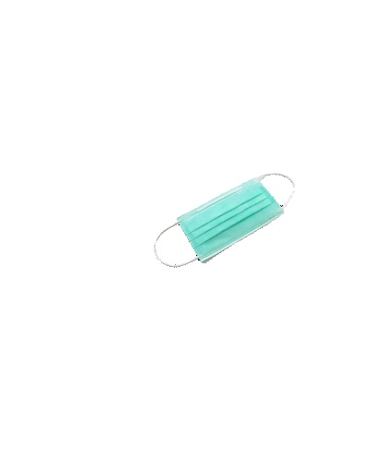
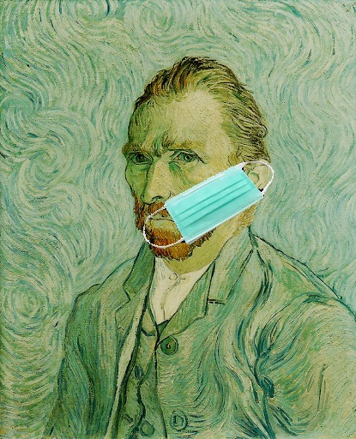
2.2 Image processing
Remove Background​
Composite
Style image
Dilation
Mask
Dilated image
Mask image
Content image
Notes:
At the beginning, we use removebgAPI to do the work of removing the background. When the real mask is obtained, the next step is to make the composite image, and the currently needed images are content image, mask image, and dilated image.
Now make the content image, so first select a base image as a style image, and process the image that has just been removed through the Opening Operation (corrosion first, swell, remove white noise), merge the input coordinates with the style image to get the output,
and use the same way to use the same size white picture as the background, do the same as Opening Operation to generate the picture we need, and finally use the picture through the Open cv to do the mask and dilation
剛開始使用removebgAPI做移除背景的工作，當取得去背的圖後，接下來就是要做合成圖片，而在目前需要的圖分別有content image、mask image、dilated_mask_image，現在做出content image，所以要先選 一張底圖，為style image，並將剛做完去背的圖片透過Opening Operation做處理，(先腐蝕，後膨脹，去白噪點)，通過輸入座標和style image做融合，並輸出為，並用同樣的方式將和style image相同大小的白色圖片當作背景，一樣做Opening Operation產生要做mask和dilated_mask圖片​，最後就是產生的圖使用Open cv的套件做mask和Dilation

Slide 10
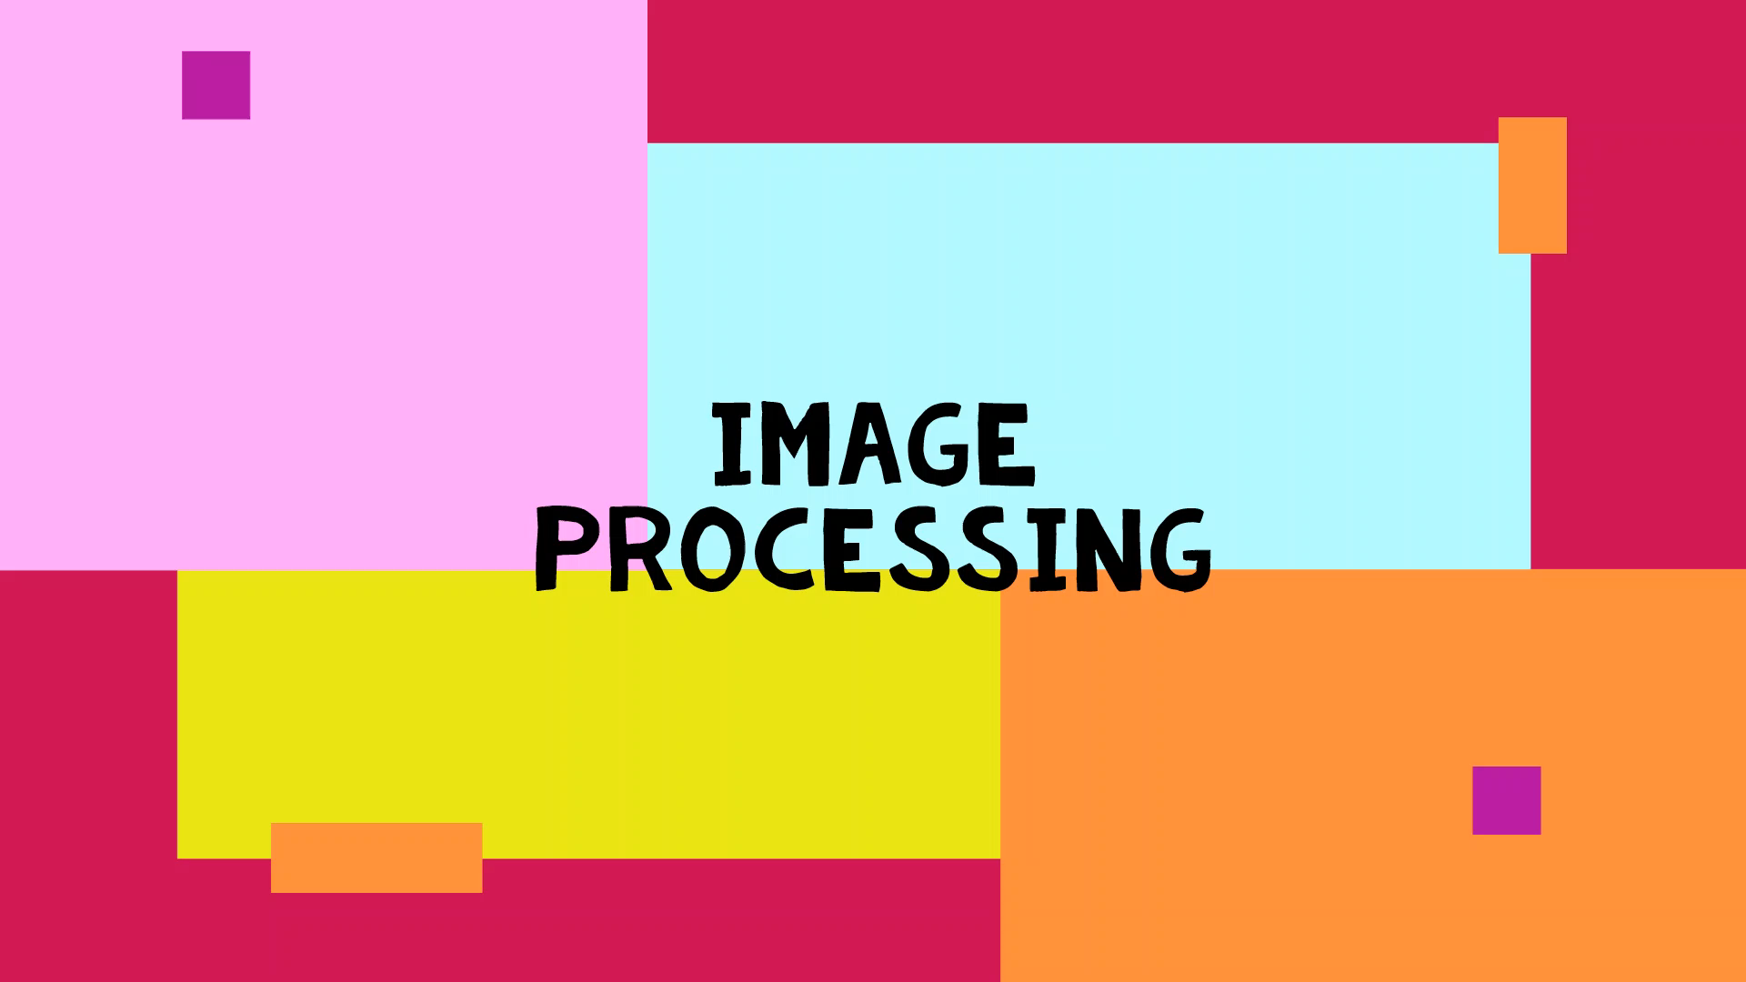
2.2 Image processing
Video

Slide 11
2.2 Image processing
Intput 4 picture
Notes:
Our input are these four picture to do the machine learning，there are style image 、mask image 、dilatation image ,content image

Slide 12
03
PART
Deep Painterly Harmonization Process

Slide 13
3.1 The First Pass
Focus on the general style
Giving an intermediate result
Compute the results of the convolutional layers for the content picture and the style picture
Compute the results of the convolutional layers for input
Compare them to these result and calculate a loss
Compute the gradients of this loss and use them to get a better input
Notes:
We will propose to make two different phases, The first one will focus more on the general style, The input is the content picture for phase 1, the result of this first stage for phase 2. In both cases, we'll compute the results of the convolutional layers for the content picture and the style picture at first, compare them to calculate a loss from that and compute the gradients of this loss and use them to get a better input

Slide 14
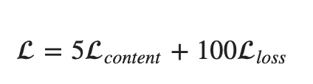
3.1 The First Pass-Loss function
1
Content Loss
Measures the difference between input and the content image
2
Style Loss
Measures the difference between input and the style image
3
Cosine similarity
Measure how much two patches look alike
4
Gram matrices
Take the mean-squared error to give the style loss
5
Final loss of this first stage
Notes:
In this page , we will introduce five Loss function for calculate image process of loss
First : Content Loss. : Measures the difference between input and the content image
•
Second : Style Loss : Measures the difference between input and the style image
Third : Cosine similarity Measure how much two patches look alike
Fourth : Gram matrices Take the mean-squared error to give the style loss
Five content Loss plus one hundred Total Loss
Fifth : Final loss of this first stage is this

Slide 15

3.1 The First Pass
Video
Notes:
This is my first pass demo Video:
In this step ,We will defined layer name and replace layer with layer name , and then we can call lt in this model
The Step , we can launch the training ,total run 1000 times , Every one hundred print total loss style Loss and content loss

Slide 16
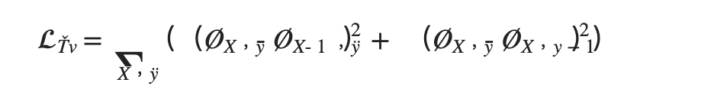
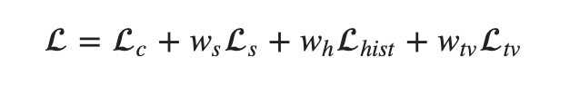
3.2 The Second Pass
Smoothening the edges during the first part
Normalization
Used the minimums and maximums of the output features
Final loss of the second stage
Notes:
The second phase will focus smoothening the edges that could have appeared during the first part
First we use this time the convolutional layers number 1, 2, 3 and 4 for the style loss (and take the mean of them), and the fourth convolutional layer for the content loss. To add more details to the final output, they also consider two more losses. The first one, the Total Variation loss, just sums the difference between adjacent pixel values, which will insure the result is smoother
Second pass we apply a mask with n1 elements for the style features and a mask with n2 elements for the input features we compute the gram matrix of the style features, the square root will disappear and we will multiply the result by n2/n1, which is a way to resize this sum of n1 elements to a sum of n2 elements At the end, those four losses are summed with some weights to give the final loss of the second stage is this
Content loss plus style weight multiply by style loss plus Histogram weight multiply by Histogram loss plus Total variational loss multiply by Total variational weight
Histogram loss often used to modify a certain photograph with the lightness or shadows of another , define another loss could help preserve the textures of the style picture

Slide 17
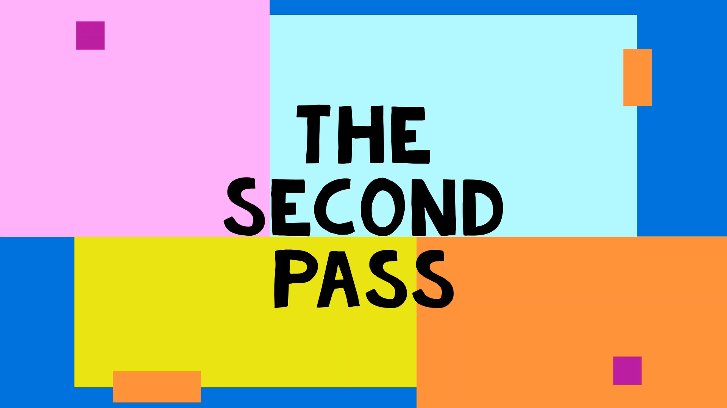
3.2 The Second Pass
Video
Notes:
This is my second pass demo Video:
we can get our training to start t, total run 1000 times , Every one hundred print total loss style Loss and content loss histogram Loss and variational loss

Slide 18
04
PART
Result

Slide 19
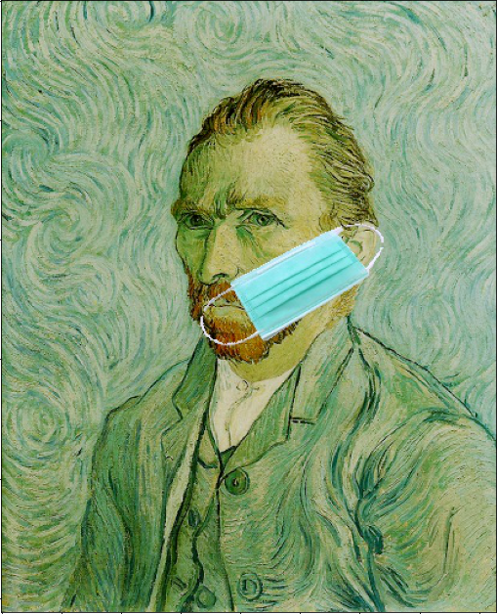
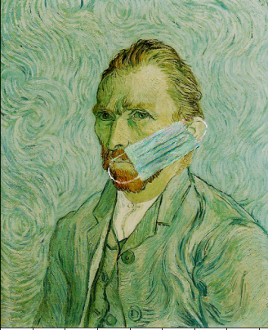
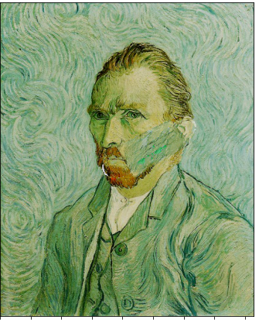
4.1 Result
original
Output 2 picture
Notes:
So , then will output 2 picture is pahas1. and phase 2 compare with original picture

Slide 20
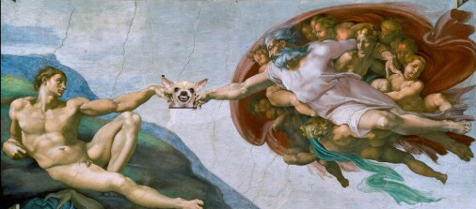
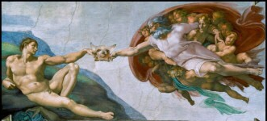
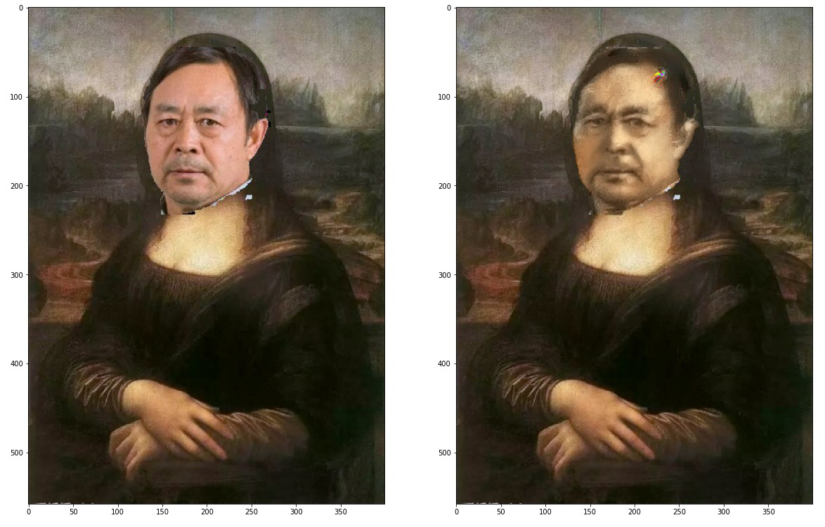
4.1 Other Result
Notes:
And then we display. Other Result

Slide 21
05
PART
Conclusion

Slide 22
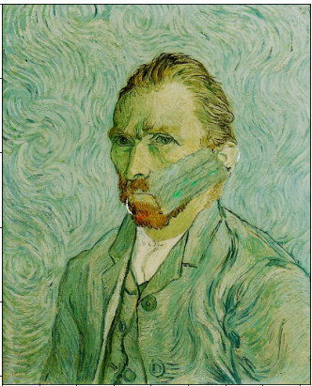
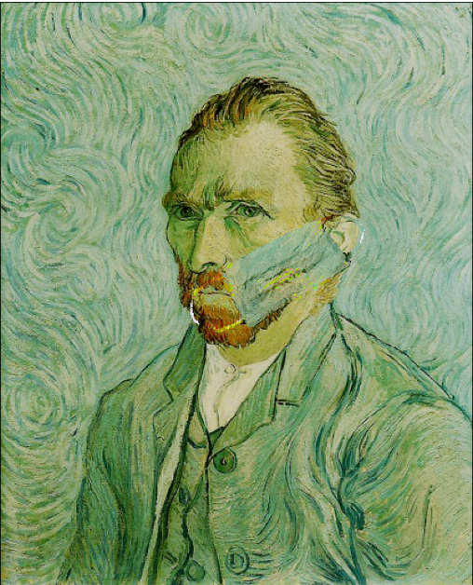
5.1 Conclusion
Make the necessary picture materials by ourself
We used a different algorithm(VGG19->VGG16)
 | VGG_16 | VGG_19
Output
Time | 4min 21s | 4min 38s
Notes:
The difference between us and the paper is that we make the pictures we need and use the pytorch to complete the training.
And we use different algorithm to get the result. Then paper only use VGG19 to do training, and we used VGG16 to compare the differences, the result is that VGG16 results are already very good, and the use of time is a little less than VGG19,because VGG19 is much deeper, but VGG19 results have overfitting situation，
So we thought it might be caused by different ways of working with pictures, but the conclusion was that it was enough to just use VGG16

Slide 23
5.1 Conclusion
Our Limit
We can only manually change coordinates when we make composite pictures
Hardware is our biggest limitation, picture size can only be below 600pixel

